Slide 1
Section 5
Finding lane lines

Slide 2
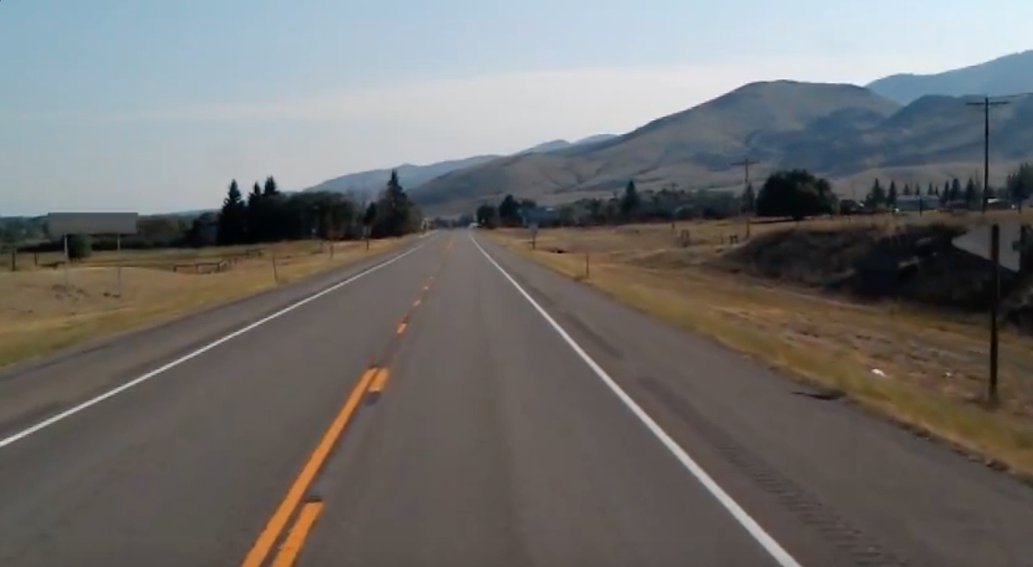
Goal with this section
Introduction to OpenCV and how to use it to pre-process images
Use OpenCV to find lane lines in this image

Slide 3
Steps done
Convert image to grayscale
Smoothen with Gaussian blur
Detect edges with Canny edge detector
Define a region of interest
Use Hough transform to find lines
Plot the found lines on the original image
Use the same steps for a video!

Slide 4
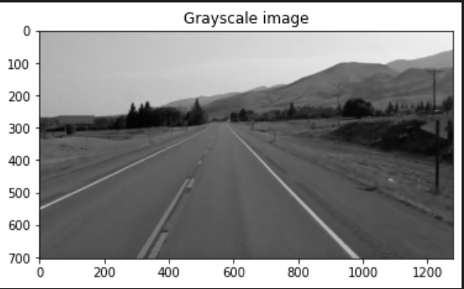
Grayscale conversion
1 color channel instead of 3 (RGB)

Slide 5
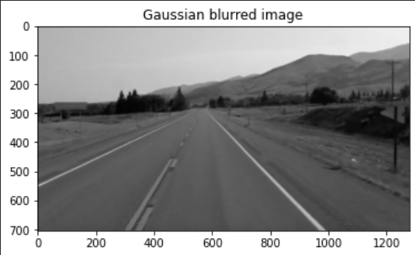
Smoothen with Gaussian blur
To reduce noise in the image
Smoothes out the image
Each pixel value is set to average of neighbors

Slide 6
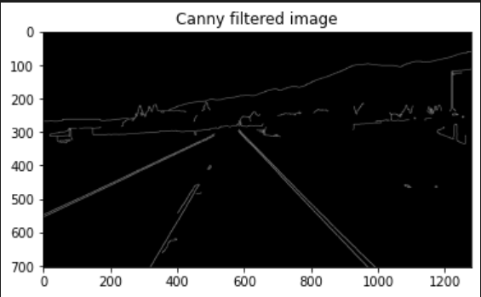
Canny edge detection
Operator for rapid changes in directions
Computes gradients in all directions, then traces the strongest gradients
Strongest gradients = edges
Threshold parameter decides which edges are included

Slide 7
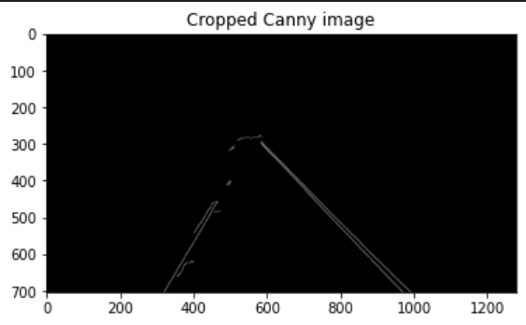
Define a region of interest
A triangle used as a mask
Mask * image = cropped image

Slide 8
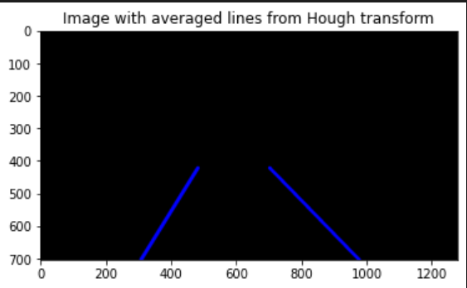
Find lines with Hough transform
All edges from Canny are lines in xy-space and points in Hough space
Find the place in Hough space with the most points
Place with many points in Hough space = lane-line in xy-space

Slide 9
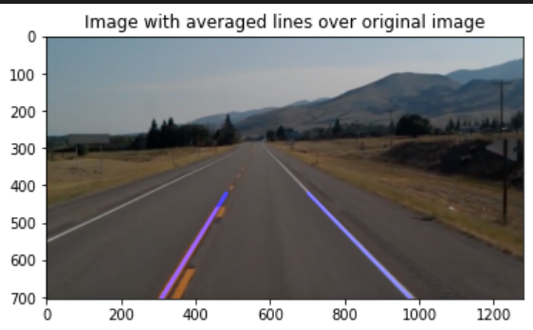
Found lane lines

Slide 10

Video that we want to find lane lines in

Slide 11
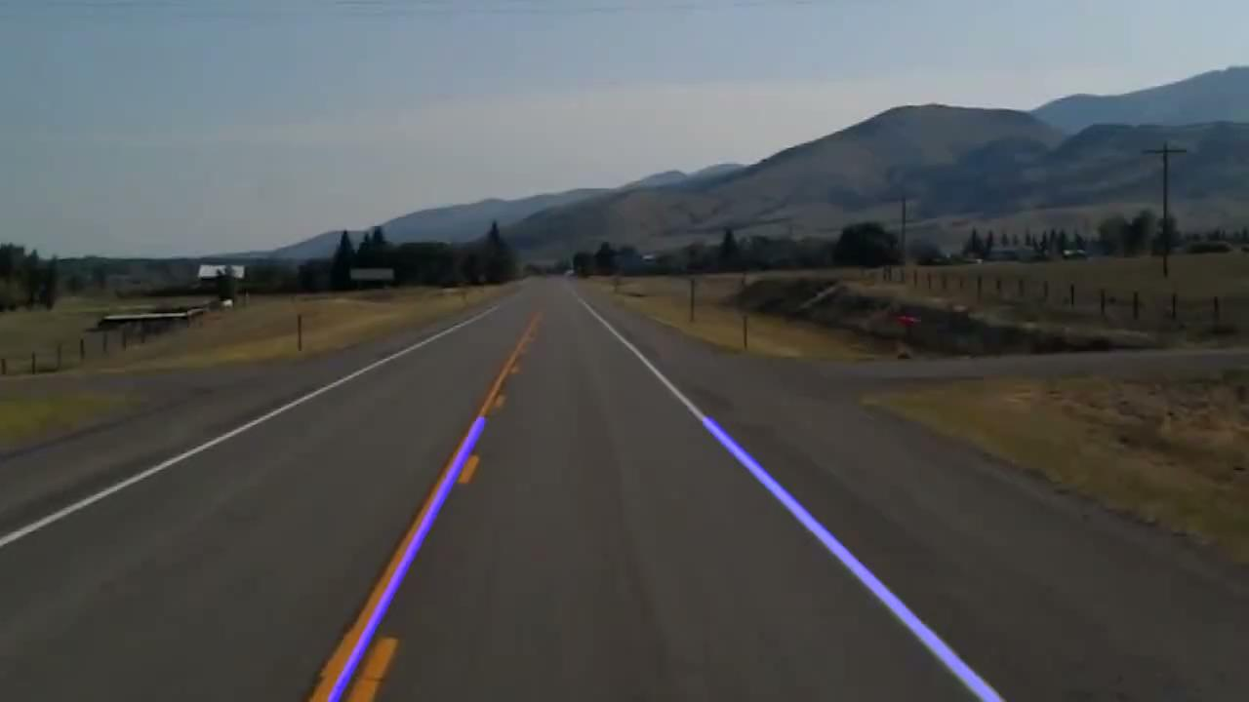
Video with found lane lines

